Slide 1
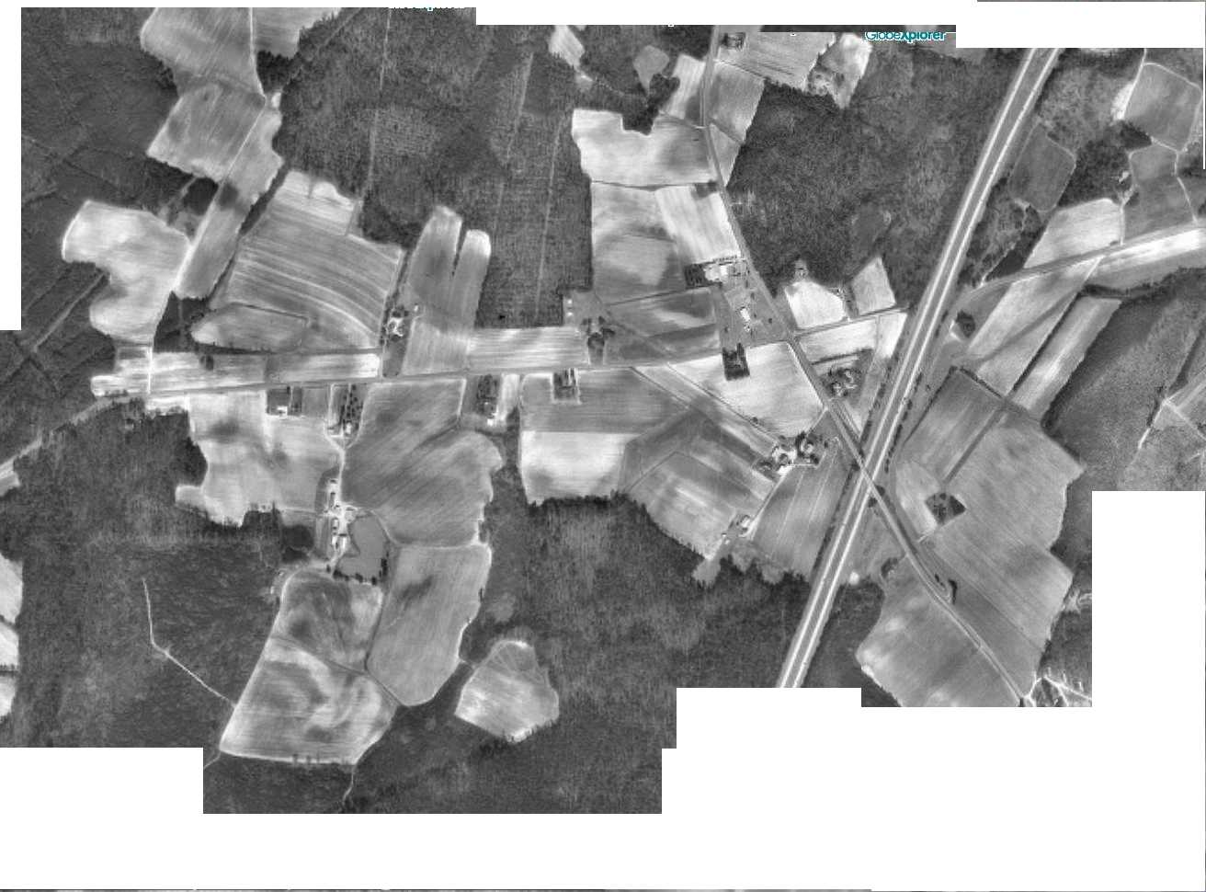
A
A
A
A
A
B
A
A
A
A
A
A
A
A
A
A
A
A
A
A

